Slide 1
Pedicled Vascularized Calcaneus Transfer: A Novel Surgical Technique for Tibial Deficiency To Improve Functional Outcome
William H Fang OMS2, MS^{1,2}
Evelyn Thomas, DO ^{2,3}
Juston Fan, DO ^{2,3}
Amber R. Leis, MD ^{3,4}
Samuel R. Rosenfeld, MD ³
¹ Western University of Health Sciences, Pomona, CA
²Orthopaedic Surgery, Riverside University Health System Medical Center, Moreno Valley, CA
³Orthopedic Surgery, Children’s Hospital of Orange County, Orange, CA
⁴Plastics Surgery, University of California, Irvine, Orange, CA

Slide 2
DISCLAIMER
All data collection was performed at Children’s Hospital of Orange County, Orange, CA
Informed consent was obtained from the mother for the publication of this case report.
Speaker: William H Fang, M.S.
The authors have no conflicts of interest to disclose

Slide 3
TABLE OF CONTENTS
Background
01
04
Treatment
02
Case Presentation
05
Follow Up
03
Diagnosis
Tibia Deficiency
06
Discussion

Slide 4
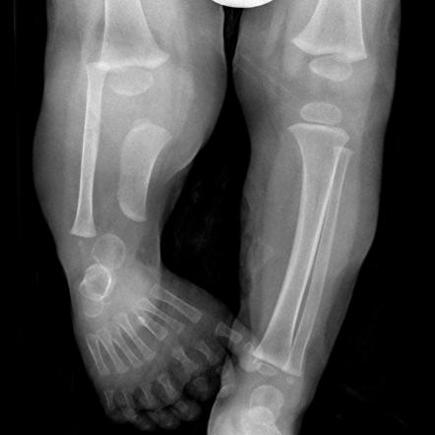
01
Background
Tibia Deficiency / Tibia Hemimelia

Slide 5
Tibial Deficiency (TD)
Spectrum of Deformities of the Tibia
Ranging from a hypoplastic Tibia to the complete absence of the bone.
Very rare, one in one million live births
Notes:
Often subdivided into different types
A congenital congenital lower limb deficiency that involves a spectrum of deformities of the tibia, ranging from a hypoplastic tibia to the complete absence of the bone.

Slide 6
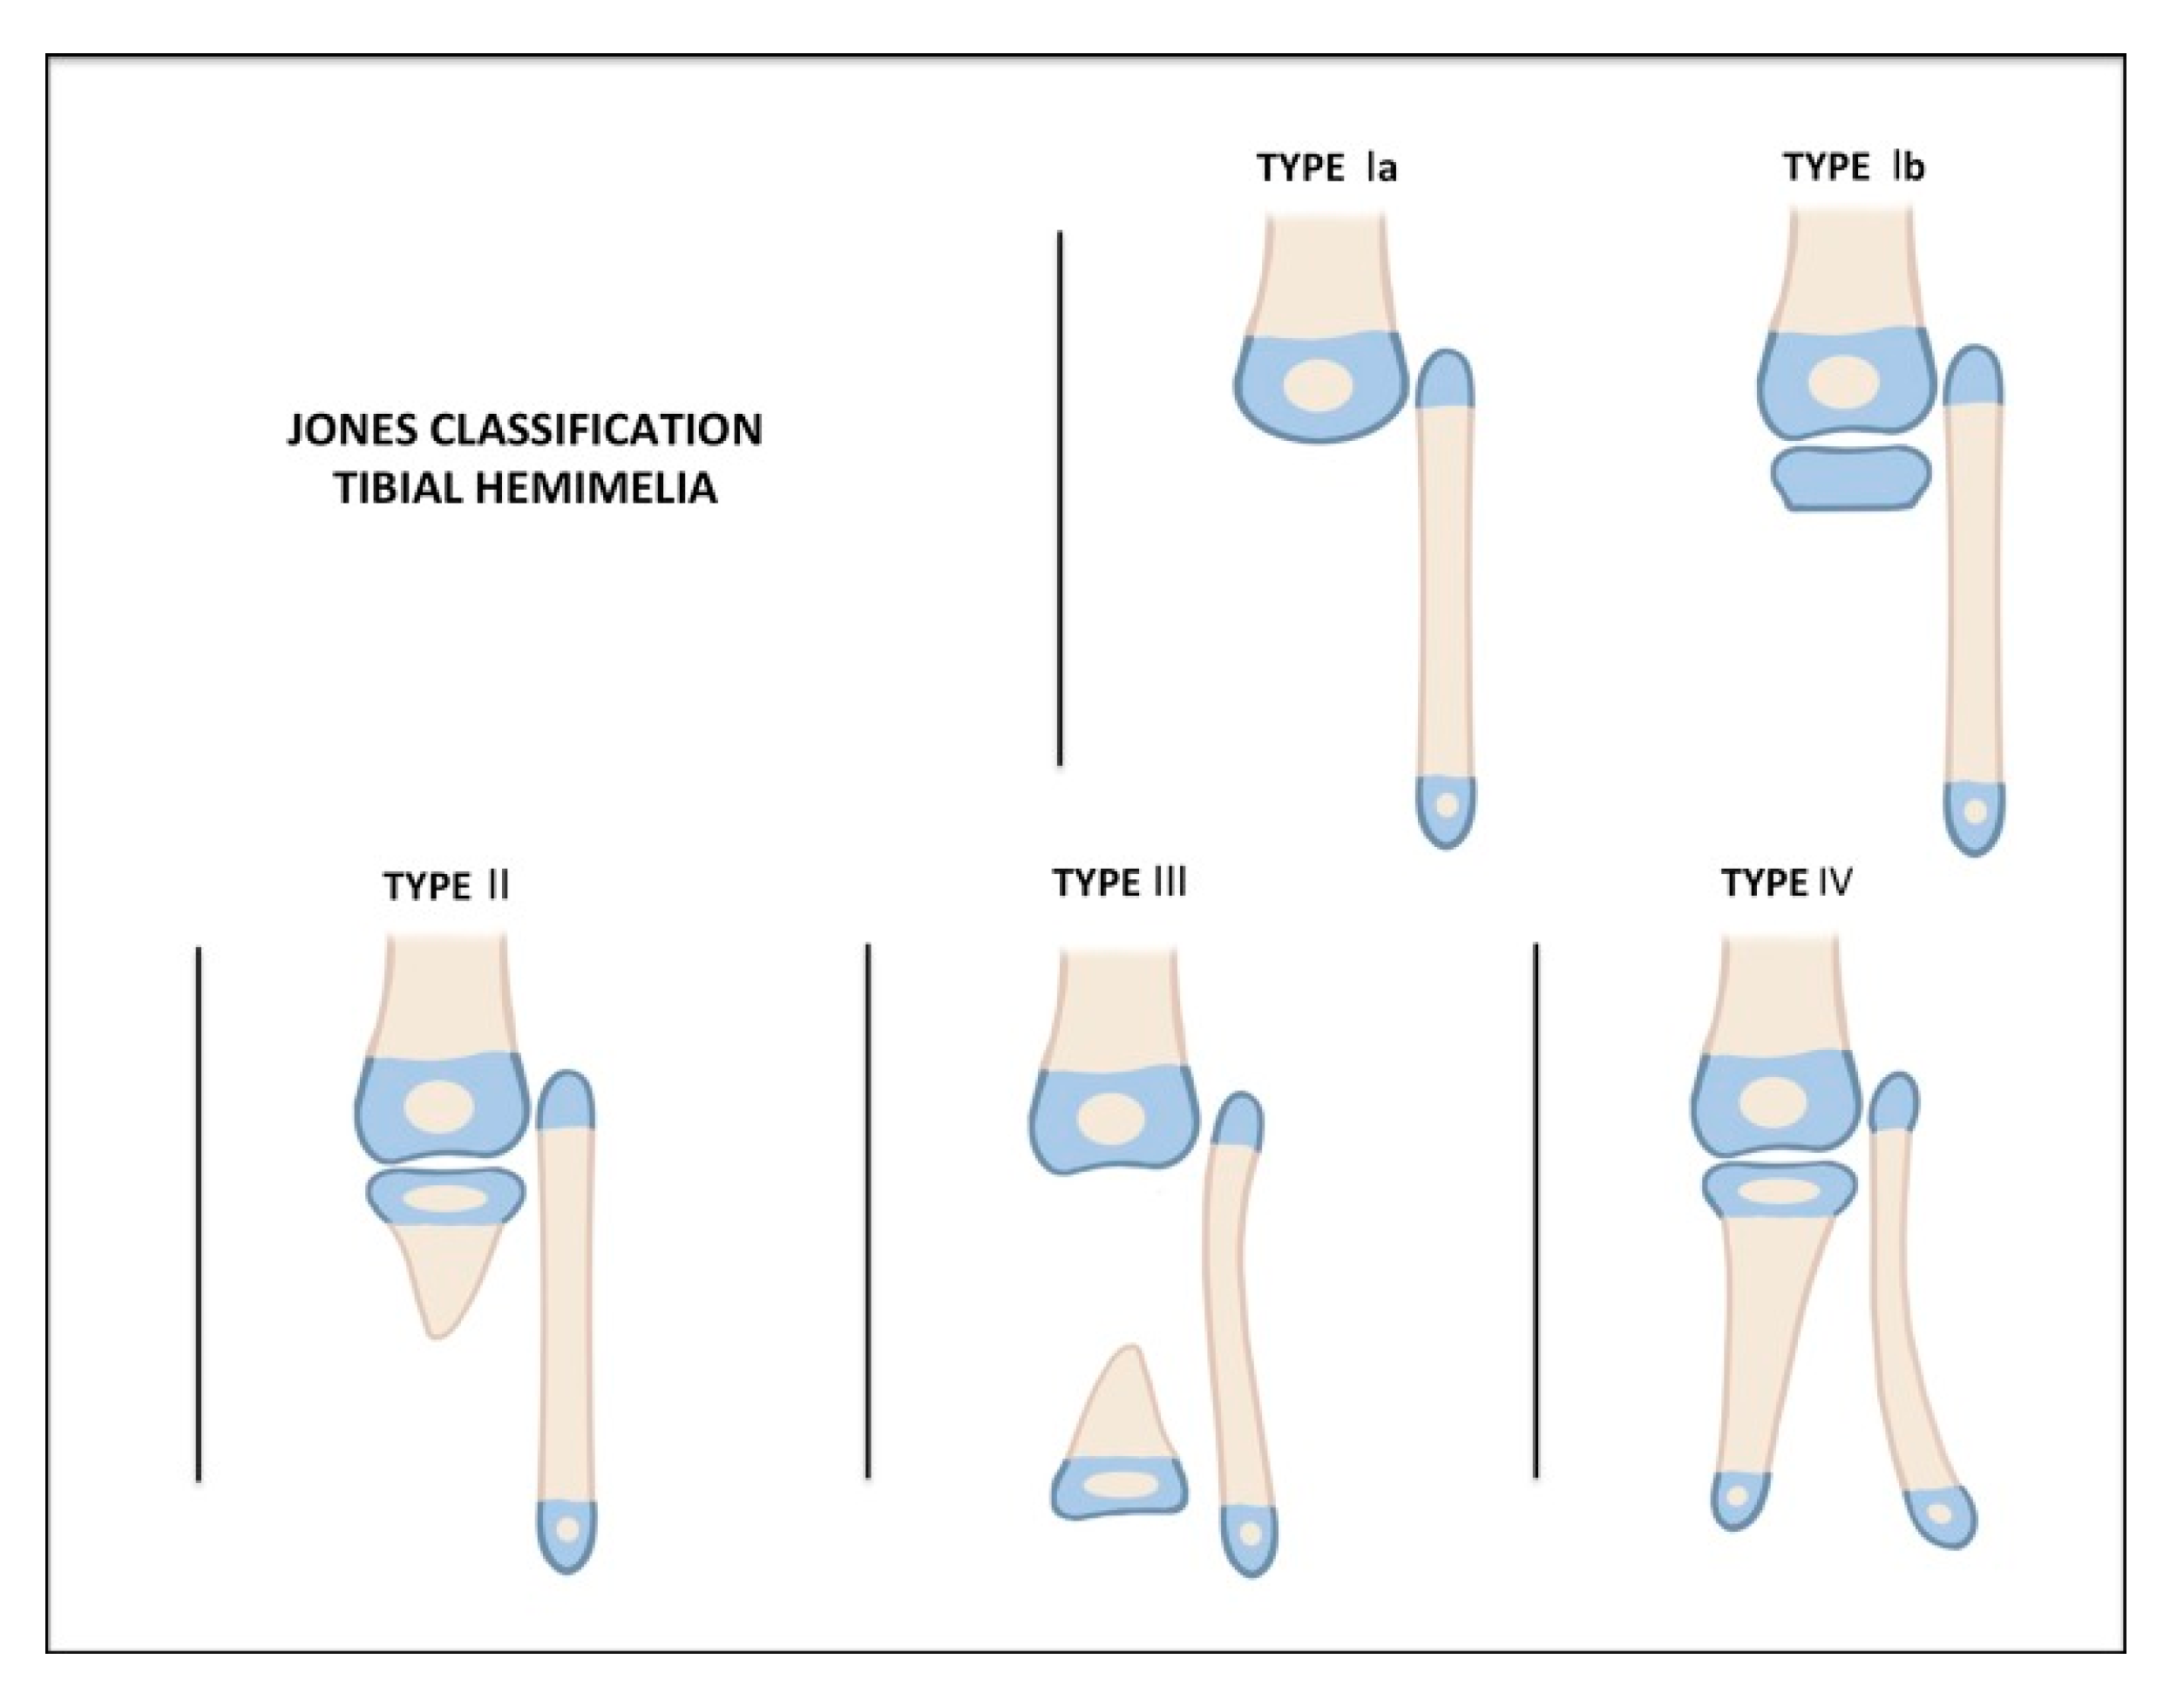
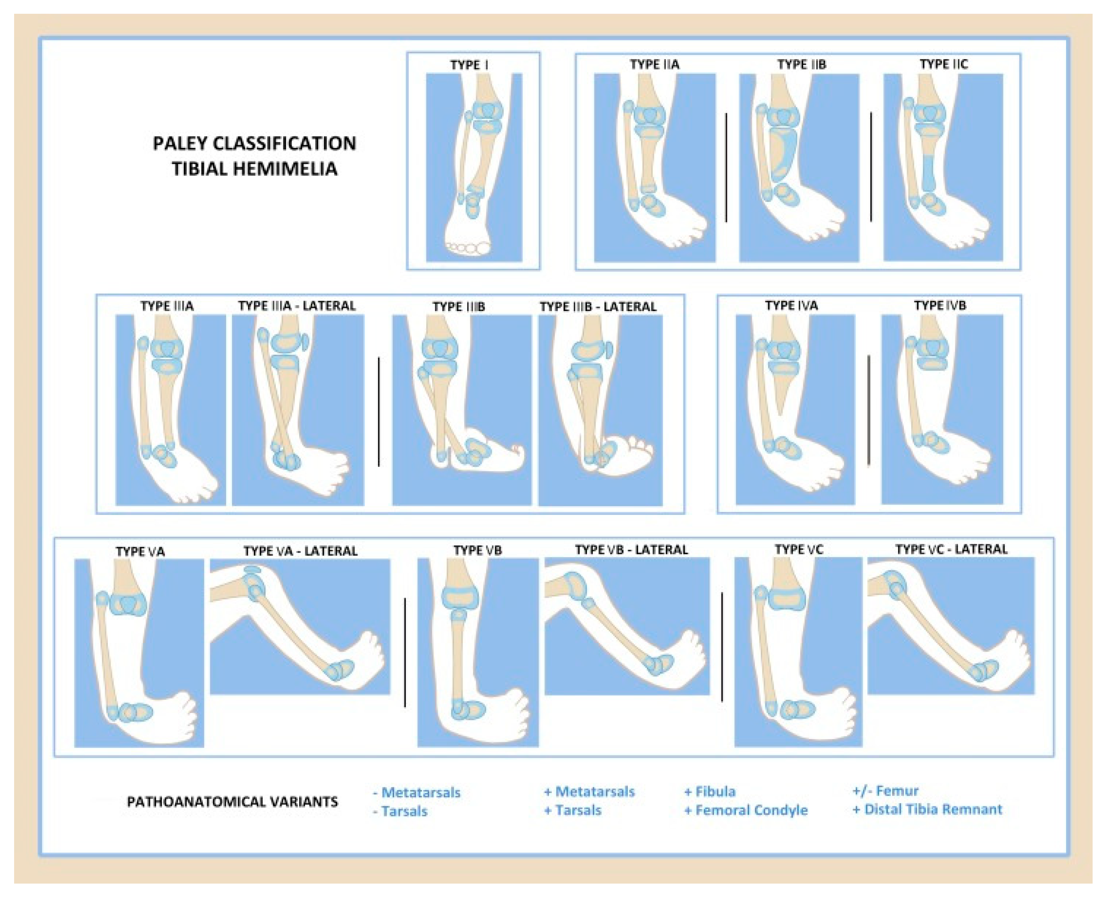
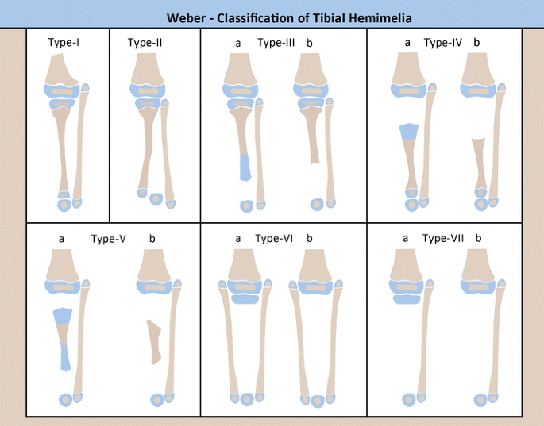
Classifications
Notes:
1978 Jones classification is commonly used in clinical diagnosis and uses radiographic imaging to classify deformities in four separate categories.
Additionally, the Weber classification was published in 2007 and takes into account the entirety of the affected leg, while further subdividing groups based on whether cartilage anlage was present
Proposed in 2003, modified in 2016
Based on the type of TD and accompanying surgical and reconstructive options

Slide 7
Wide Spectrum of Presentation
Treatment is Difficult
Many presentation of TD with Tibial Absence (Jones Type 1) report early ablative procedures or partial amputations
This case report demonstrate a novel limb salvage treatment of a young child presenting with bilateral tibial hypoplasia
Notes:
In the case reports that discuss reconstruction, treatment delineates based on the amount of residual anatomy present and many require prolonged staged-reconstruction that may take months, which can be detrimental for the patient’s development. To date, there is a lack of reconstructive techniques that prioritize functional outcome and reduced recovery time to promote normal developmental milestone achievement.

Slide 8
02
Case Presentation

Slide 9
PATIENT MEDICAL HISTORY
AGE: | 2 Months
GENDER: | Male
39 week gestation
2 Months
12 Months*
Presented to the Clinic
Bilateral Calcaneus Transfer Surgery
Routine ultrasound imaging indicated the patient had absent bilateral tibias

Slide 10
PHYSICAL EXAMINATION
Shorted Bilateral LE
Dimpling at Knees
Left Foot Hypoplastic
Bilateral Popliteal Pterygiums and Tibial deficiencies
Rigid equinovarus and supination deformities

Slide 11
03
Diagnosis

Slide 12
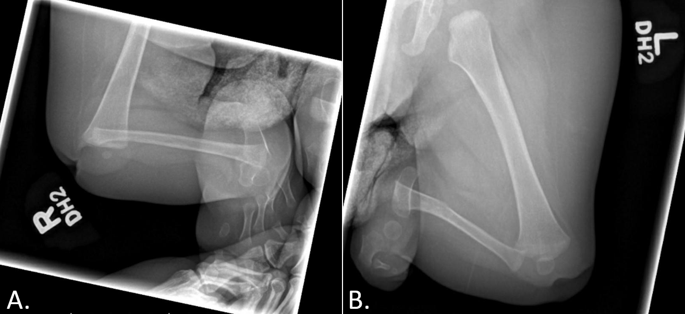
Plain Radiographs
Paley 5c
Jones I
Classification
Radiographic when the patient was 8 months old. (A). Anteroposterior view of the right lower extremity; (B). Anteroposterior view of left lower extremity
Notes:
R Demonstrates absent tibia with dislocation and severe flexion contracture of the knee, and subluxation or dislocation of the ankle
L Demonstrating absent tibia with dislocation or subluxation of knee and dislocation of ankle.
absence of the tibia and multiple bones of the foot on the left side. Subluxation or dislocation of the left knee and dislocation of the left ankle was also noted

Slide 13
04
Treatment

Slide 14
Bilateral Calcaneus Transfer (R)
Right forefoot, midfoot, and talus were excised.
The right fibula was carefully excised via subperiosteal dissection, preserving the vessels and nerves.
The calcaneus brought to end of the femur and fixed with a smooth Steinmann pin
Notes:
The articular cartilage of the distal femur was also sharply excised.
inserted through the plantar calcaneal skin, through the calcaneus, and into the medullary canal of the femur

Slide 15
Bilateral Calcaneus Transfer (L)
The talus and remaining metatarsals and toes of the hypoplastic left foot were carefully dissected
The left fibula was excised via subperiosteal dissection, preserving the vessels and nerves
Leg length equal- distal femur shortened with midshaft osteotomy removing approximately 3cm
Smooth Steinmann pin was then inserted, calcaneous, and into the medullary canal of the femur
Notes:
There was a severe knee flexion contracture, and the entirety of the left foot pad was tethered to the proximal groin with pterygium which created a challenge in terms of preservation of tissue vascularity during the transfer. The tethering structures included the deep muscle fascia of the femur, which was released. Femoral nerve neurolysis was performed to allow for further mobility. Although the tissues were mobilized maximally, the stretch required to reach the end of the femur resulted in blanching of the flap.
pedicled vascularized calcaneus transfer was performed, allowing for transfer of the calcaneus along with the overlying glabrous skin and soft tissues to the end of the femur. The flaps were designed to incorporate residual nerve structures to preserve sensation to the calcaneal skin as well as reduce the risk of neuroma formation.

Slide 16
Wound Closure
Mercury

Slide 17
05
Follow Up

Slide 18
4 Week Post-Op
Steinmann Pin Removal
Notes:
The patient was kept non-weight bearing for 4 weeks with soft dressings overlying the lower extremity. Dressings were changed in clinic at regular intervals. The patient was permitted to bear weight after the 4-week post-operative follow-up.

Slide 19
6 Week Post-Op “Stubbies”
Notes:
Outdoor weightbearing

Slide 20
8 Weeks Post-Op
Crawling Without Complaints of Pain

Slide 21
6 Month Post-Op
Pull to Stand + Walk with Assistance
Notes:
patient was able to pull to stand and walk with assistance without any complaints of pain. No complications have been noted up to date at 9-month follow-up (Figure 8). The patient will continue to be followed routinely to monitor his progress.

Slide 22
06
Discussion

Slide 23
DISCUSSION
Complex And Challenging Condition
Literature: Early Reconstructive Efforts – Amputation Common
2016 Paley Proposed 2 Stage Surgery
This novel reconstructive technique allowed for the preservation of calcaneal skin sensation, reduced the risk of neuroma formation, and avoided amputation or prolonged staged reconstruction
Notes:
In the present study, a patient presented with bilateral tibial deficiencies, and bilateral pedicled calcaneus transfers were carried out to allow for earlier weight bearing compared to other reconstructive procedures.

Slide 24
Single Surgery
Non-Weightbearing Recovery Time Reduced
Better Functional Outcome for Patient

Slide 25
REFERENCES
1. Weber M: New classification and score for tibial hemimelia. Journal of children's orthopaedics 2008;2:169-175.
2. Chong DY, Paley D: Deformity Reconstruction Surgery for Tibial Hemimelia. Children 2021;8:461.
3. Orimolade E, Ikem I, Oginni L, Odunsi A: Femoral bifurcation with ipsilateral tibia hemimelia: early outcome of ablation and prosthetic fitting. Nigerian journal of clinical practice 2011;14:492-494.
4. Sahoo PK, Sahu MM, Das SP: Clinical spectrum of congenital tibial hemimelia in 35 limbs of 24 patients: A single center observational study from India. European journal of medical genetics 2019;62:103666.
5. Paley D, Chong DY: Tibial hemimelia. Pediatric lower limb deformities 2016:455-481.
6. Jones D, Barnes J, Lloyd-Roberts G: Congenital aplasia and dysplasia of the tibia with intact fibula. Classification and management. The Journal of bone and joint surgery British volume 1978;60:31-39.
7. Herzenberg JE, Paley D, Gillespie R: Limb deficiency. Pediatric Orthopaedic Secrets 2nd ed Philadelphia, PA: Hanley & Belfus, Inc 2003:406-416.
8. Fernandez-Palazzi F, Bendahan J, Rivas S: Congenital deficiency of the tibia: a report on 22 cases. Journal of pediatric orthopedics Part B 1998;7:298-302.
9. Birch JG, Walsh SJ, Small JM, et al.: Syme amputation for the treatment of fibular deficiency. An evaluation of long-term physical and psychological functional status. JBJS 1999;81:1511-1518.
10. Paley D: Tibial hemimelia: new classification and reconstructive options. Journal of children's orthopaedics 2016;10:529-555.

Slide 26
THANKS!
Dr. Schlechter
Dr. Leis
Dr. Rosenfeld
Dr. Fan
Dr. Thomas
Does anyone have any questions?

