Slide 1
Investigating the Potential for Using the Gantzer Muscle Tendon in Reconstructive Hand Surgery
Kassidy Heitzmann, OMS-II¹; Hannah Curry, OMS-II¹; Tommy Wright, OMS-IV¹; Cara L. Fisher, PhD²; William F Pientka II, MD³;
Texas College of Osteopathic Medicine¹, UNTHSC Department of Physiology and Anatomy², JPS Health Orthopaedic Surgery³

Slide 2
Background
The Gantzer muscle in the forearm is also referred to as accessory head of flexor digitorum superficialis (FDS)¹, flexor pollicus longus (FPL)², or flexor digitorum profundus (FDP)⁷
Most commonly arises from FDS and inserts into FPL or FDP distally
Documented to be present in up to 68% of forearms³
Can cause compression on anterior interosseous nerve (AIN) – Kiloh-Nevin Syndrome⁴

Slide 3
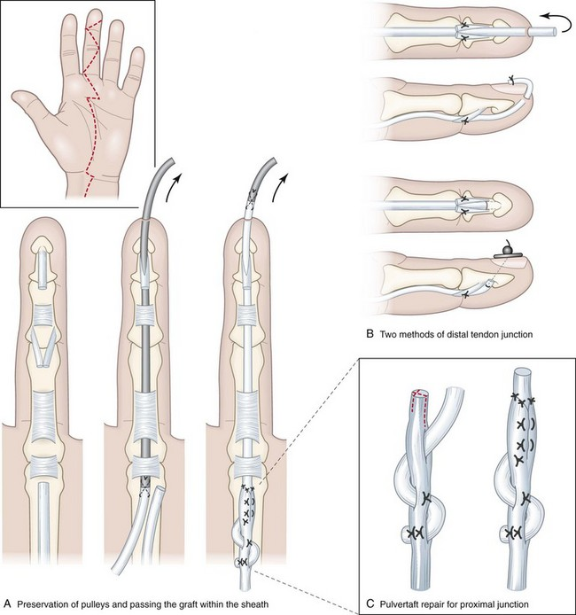
Background
Palmaris longus (PL) often used for reconstructive hand surgery – no functional deficits
Extensor^{5,6} & Flexor tendon reconstruction
PL absent in 14.9% of Caucasians in the USA⁸
https://plasticsurgerykey.com/single-stage-free-tendon-grafting-for-flexor-tendon-injury-in-fingers/

Slide 4
Purpose
The purpose of this study is to determine if the Gantzer muscle can be visualized using ultrasound and then harvested as a graft for reconstructive hand surgery

Slide 5
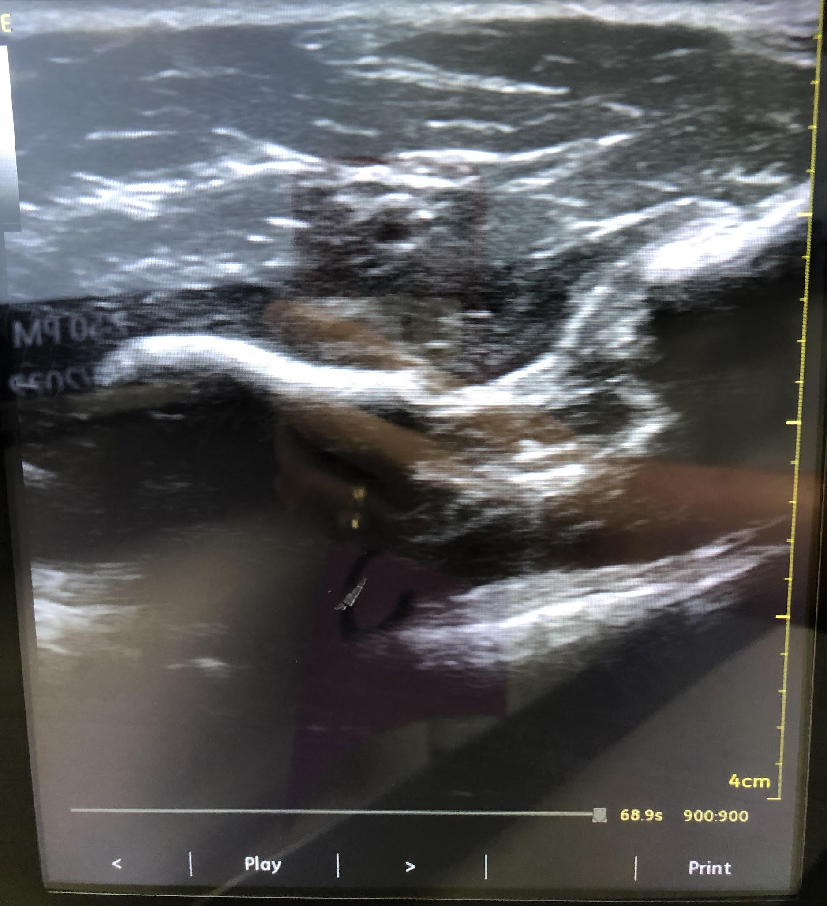
Methods
50 embalmed and fresh frozen cadaveric forearm pairs (n = 100)
33 male, 17 female
Average age = 68.78 years
Used ultrasound to look for presence of Gantzer muscle
Figure 1. Gantzer muscle tendon visualized on ultrasound

Slide 6
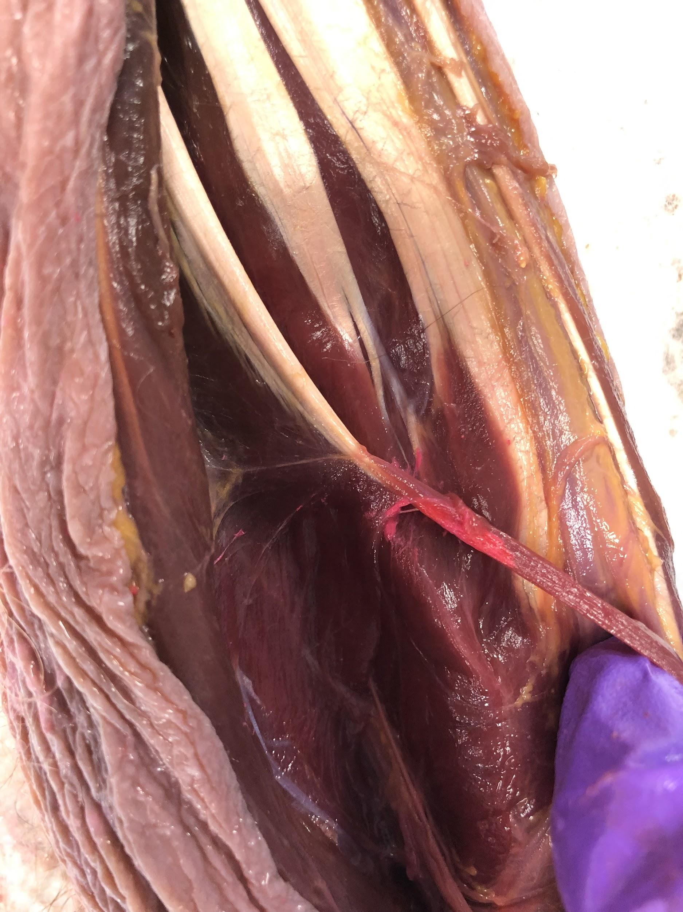
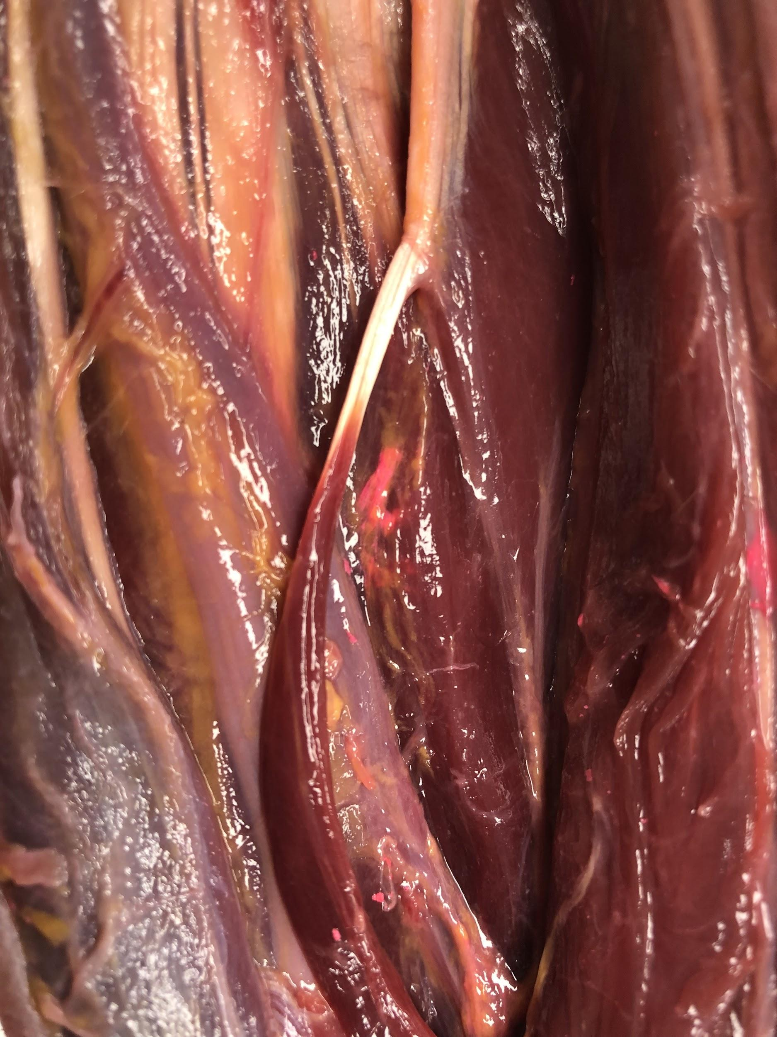
Figure 2. Gantzer muscle injected with dye using ultrasound guidance
Figure 3. Dye injected slightly past gantzer muscle into FDP
Notes:
ultrasounded 10 arms…correctly identified muscle as absent in 2 and correctly identified muscle and injected it in 3 arms
give minor info on this..here is 2 examples where we were able to identify…proof of concept

Slide 7
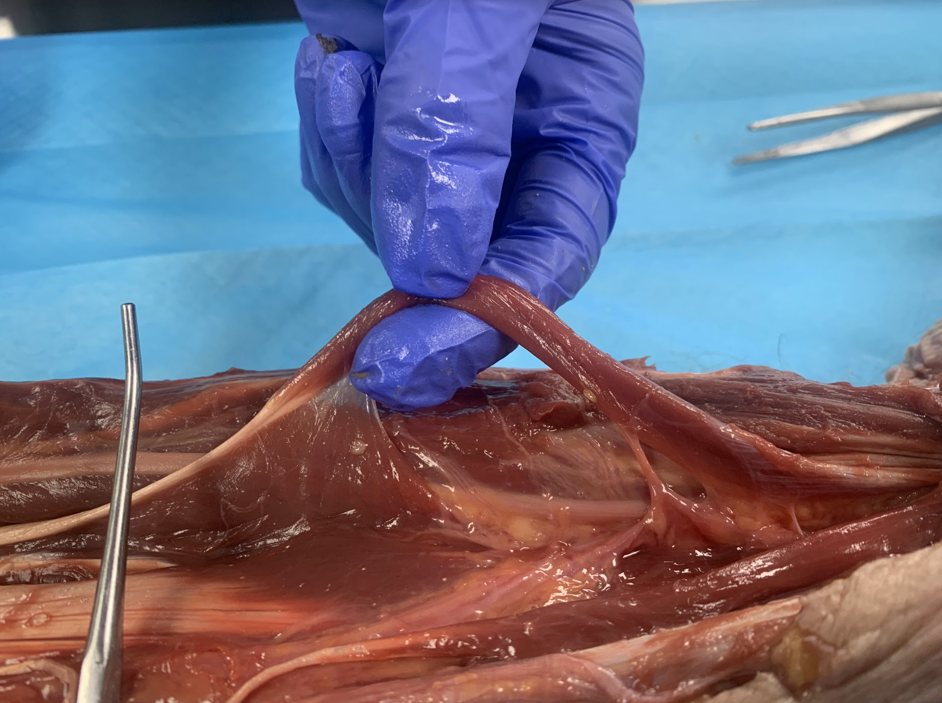
Methods
Dissected to find muscle between intermediate and deep muscle layers
Documented presence, proximal and distal attachments, and relationship with AIN
Gantzer
FPL
FDS
FDP
Figure 4. - Gantzer muscle originating from FDS and inserting into FPL

Slide 8
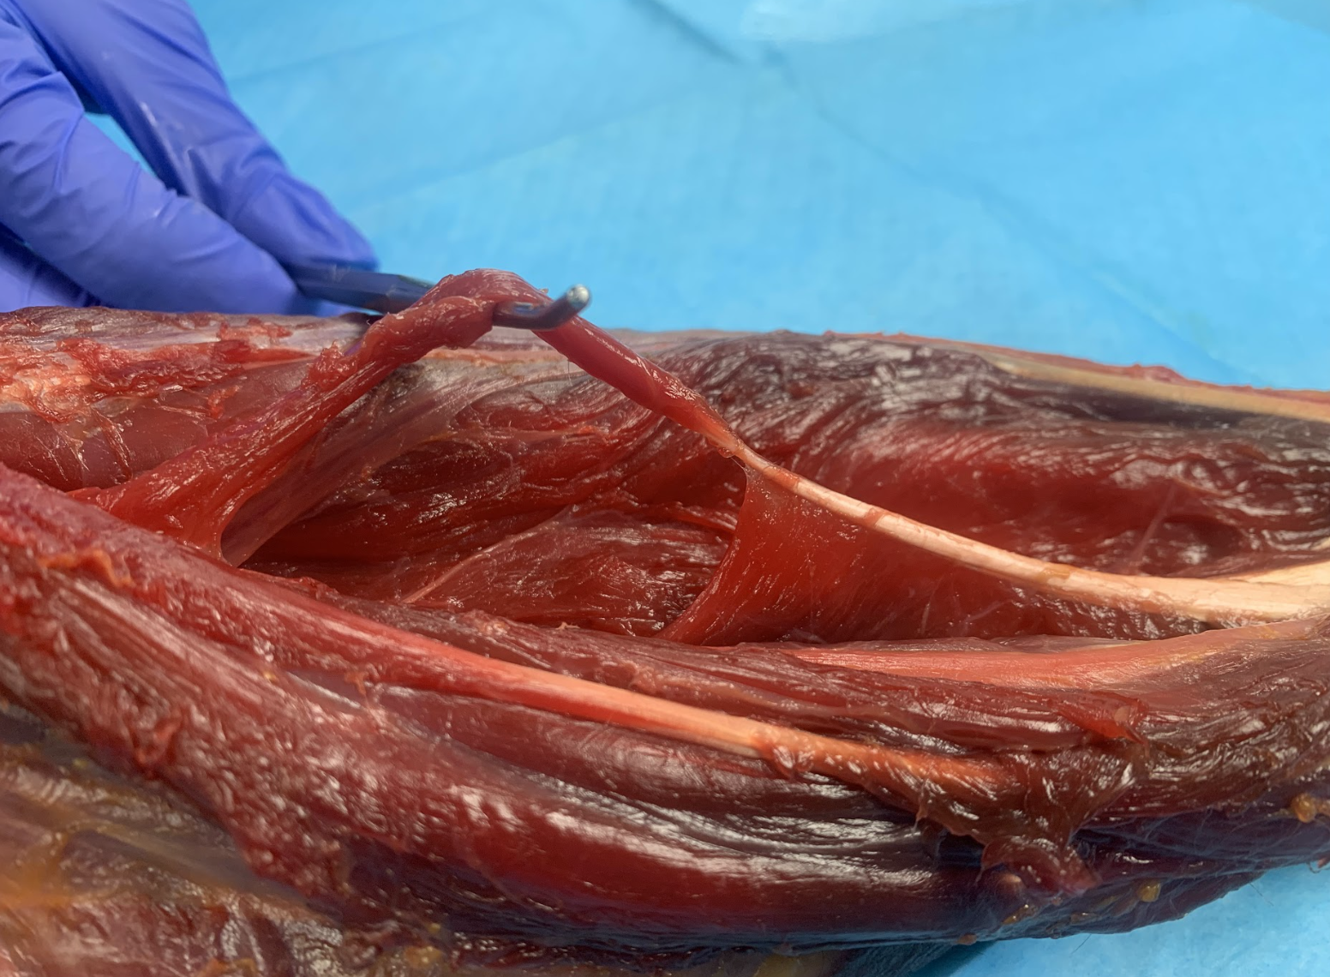
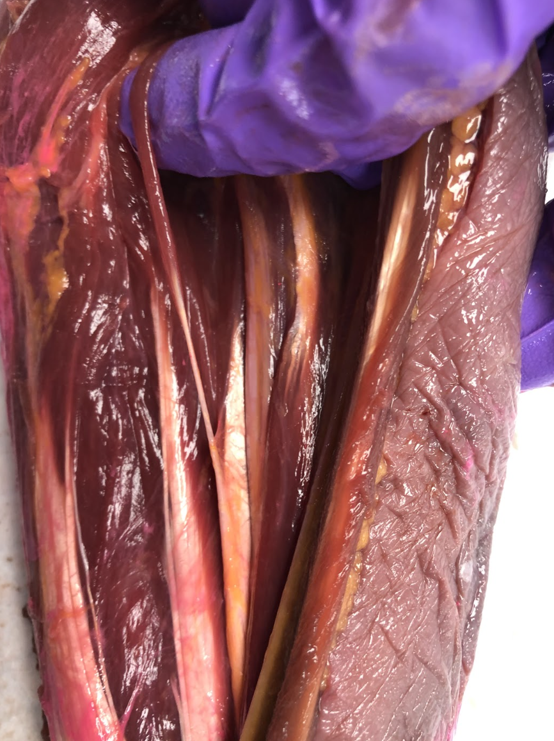
Figure 5. No functional tendon
Figure 6. Gantzer muscle inserting into FPL with short, thin tendon

Slide 9
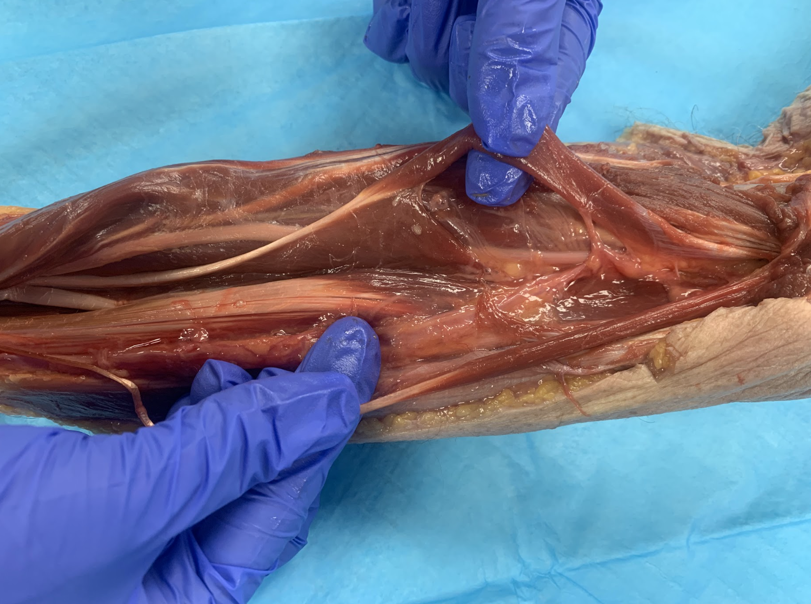
Figure 7. Two Gantzer muscles in one forearm - one attaching to FPL and the other attaching to FDP

Slide 10
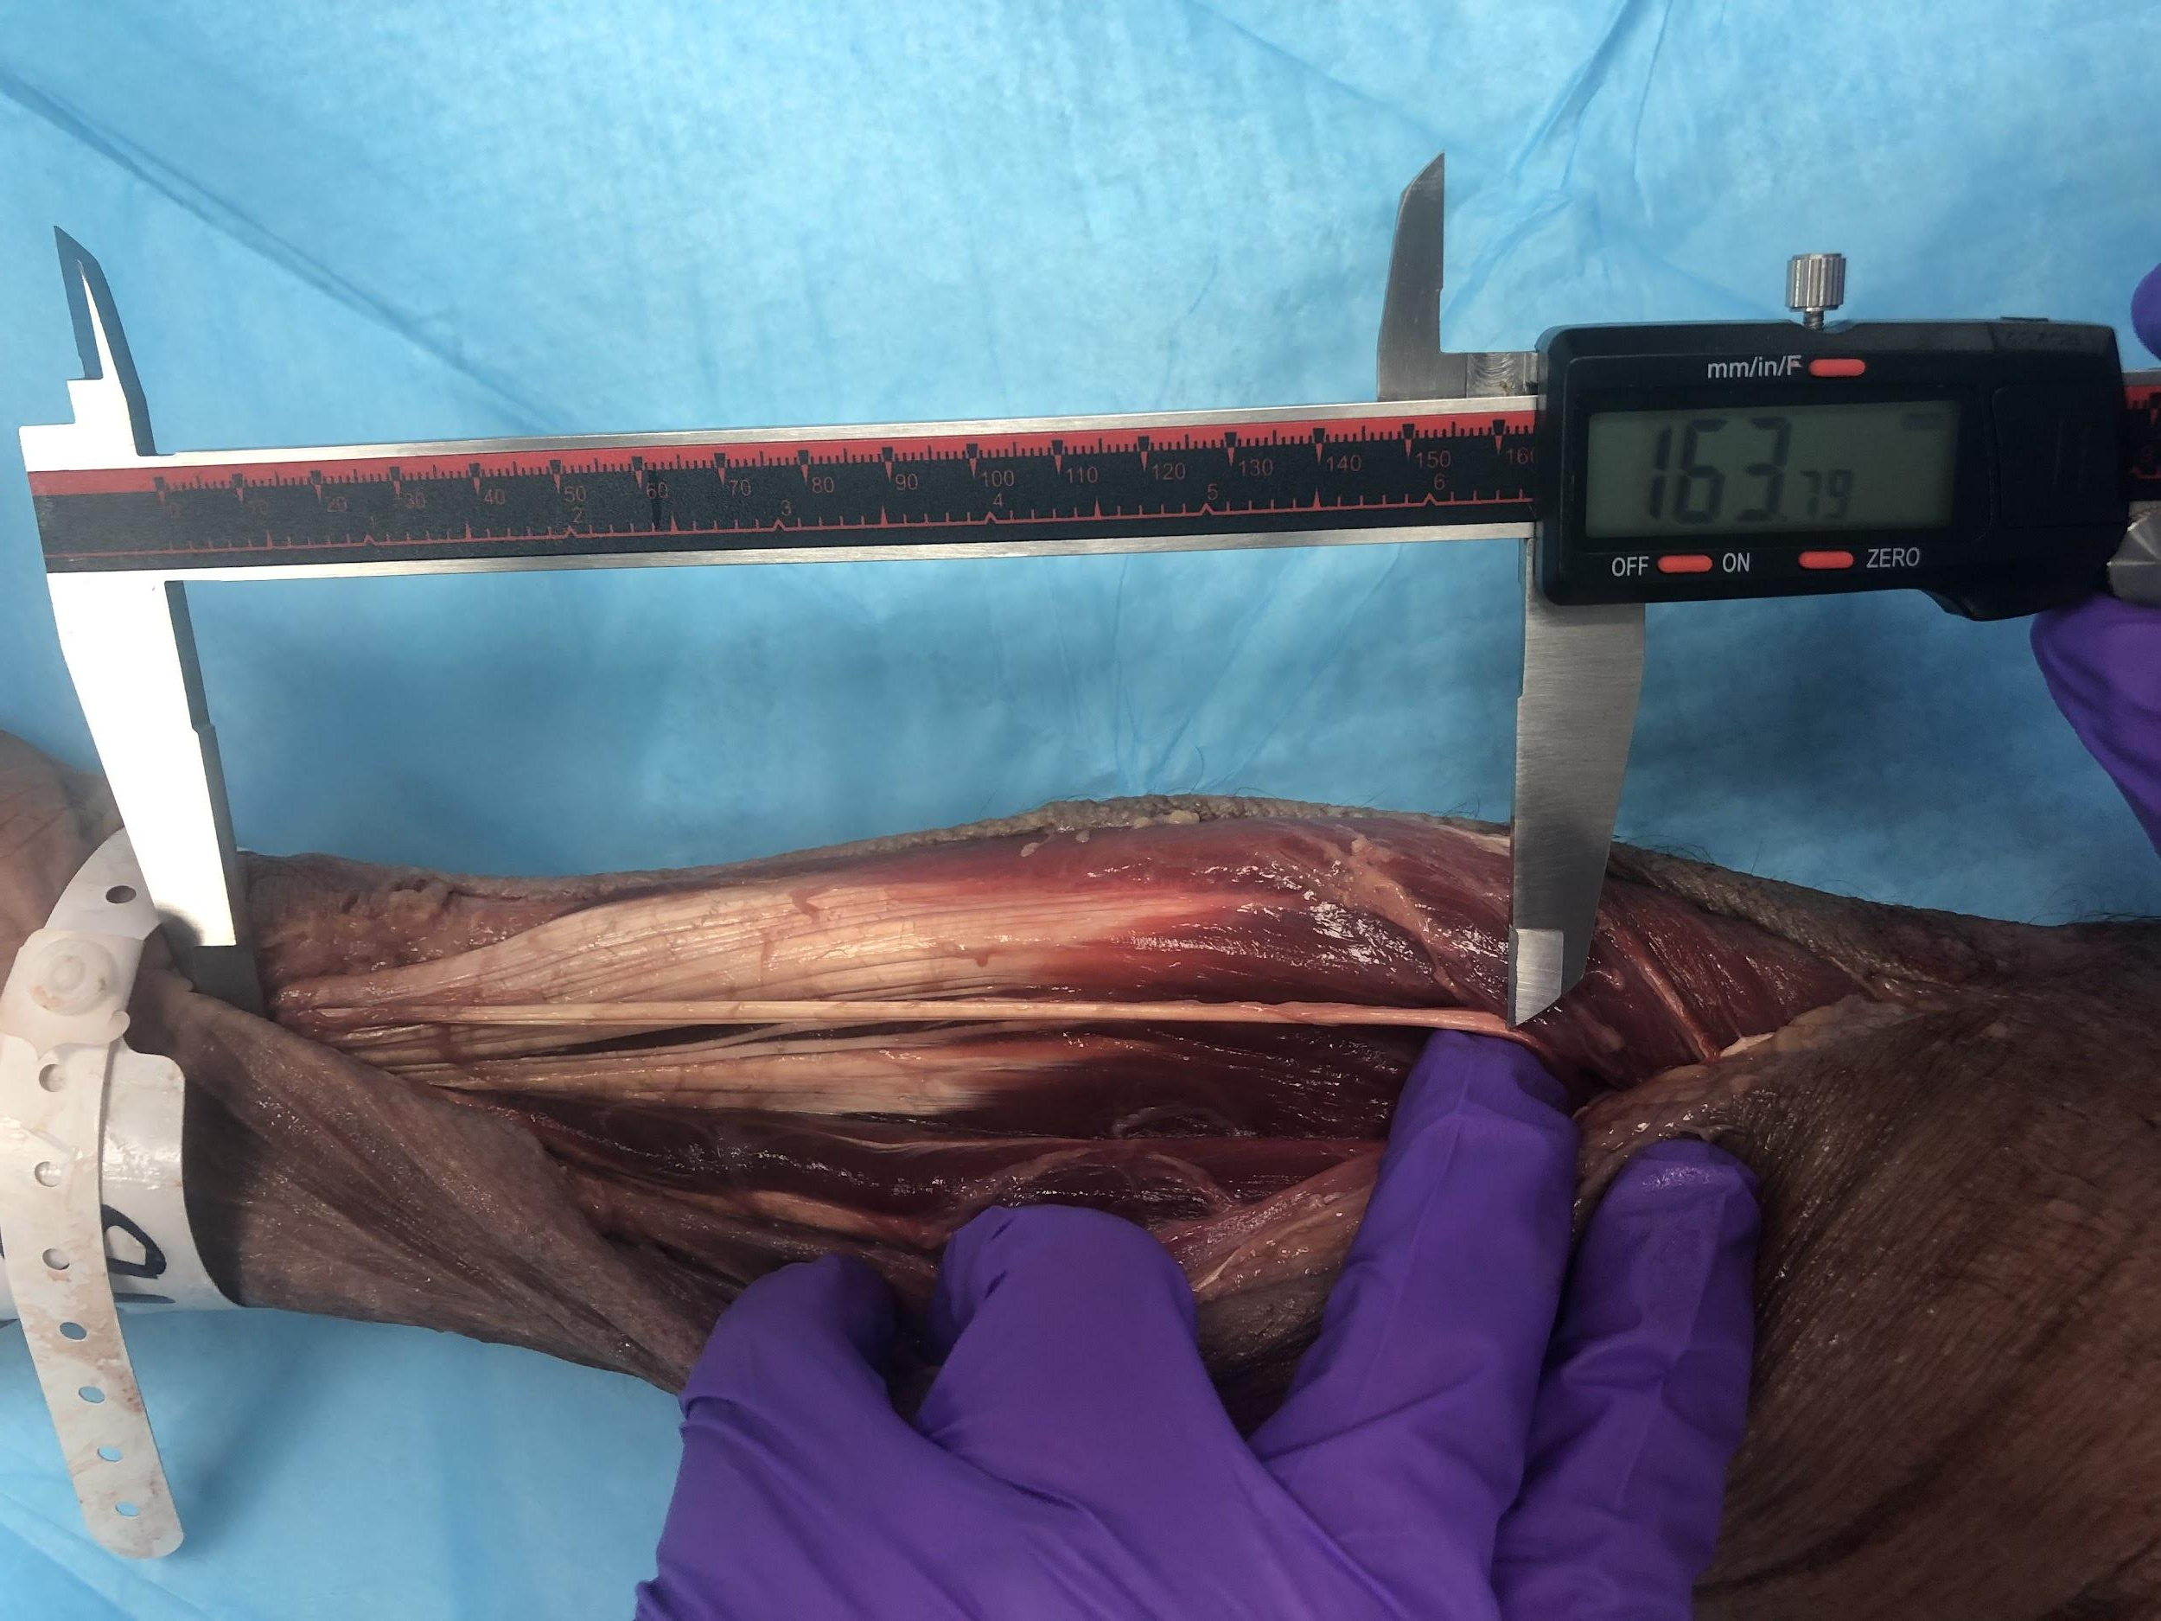
Methods
Tendon length, width, and thickness measured by 3 independent observers and average measurement was recorded
Figure 8. Gantzer muscle tendon being measured by digital caliper

Slide 11
Results
Table 1. Measurements of Gantzer muscle tendon
Prevalence = 63/100 forearms (63%)
Tendon insertion | FDP | FPL
Average length (mm) | 65.49 | 16.35
Range of lengths (mm) | 3.87-145.23 | 4.61-54.03
Average width (mm) | 2.03 | 2.41
Average thickness (mm) | 0.64 | 0.71
Non-usable tendon No. (%) | 3 (17.65) | 18 (39.13)
Most common distal attachment sites
FPL (46/63, 73%)
FDP (17/63, 27%)
PL absent in 19/100 (19%) forearms
Of those, 14 (73.68%) had Gantzer muscle
4/19 inserted on FDP (21.05%)
Notes:
include range…make table font black so it pops more …dont need to say all this just let them read the slide

Slide 12
Discussion
Table 2. Comparing measurements of Gantzer muscle tendon with palmaris longus tendon
9
 | FDP Insertion | FPL Insertion | Palmaris Longus Tendon
Average length (mm) | 65.49 | 16.35 | 116.6 ± 18.5
Range of lengths (mm) | 3.87-145.23 | 4.61-54.03
Average width (mm) | 2.03 | 2.41 | 4.2 ± 0.8
Average thickness (mm) | 0.64 | 0.71
Non-usable tendon No. (%) | 3 (17.65) | 18 (39.13)

Slide 13
Discussion
Gantzer muscle is present in a majority of forearms
If PL is absent, Gantzer is most likely present
Harvesting would create little to no functional deficit in the forearm - may even decrease risk of AIN compression
Could be a good alternative or addition to PL for reconstructive hand surgery graft
Tendons inserting into FDP would be a better choice than those inserting into FPL
Can likely identify insertion on ultrasound

Slide 14
Acknowledgements
We thank the Willed Body Program at the University of North Texas Health Science Center at Fort Worth and our donors for their invaluable contributions to this project.
Notes:
just flash this slide and dont say all of it (here are my acknowledgements)

Slide 15
References
Caetano, E. B., Sabongi Neto, J. J., Ribas, L., & Milanello, E. V. (2017). Accessory muscle of the flexor digitorum superficialis and its clinical implications. Revista brasileira de ortopedia, 52(6), 731–734. https://doi.org/10.1016/j.rboe.2017.10.004
Gunnal S.A., Siddiqui A.U., Daimi S.R., Farooqui M.S., Wabale R.N. (2013). A Study on the Accessory Head of the Flexor Pollicis Longus Muscle (Gantzer's Muscle). Journal of clinical and diagnostic research : JCDR, 7(3), 418–421. https://doi.org/10.7860/JCDR/2013/4545.2788
Caetano, E. B., Sabongi, J. J., Vieira, L. Â., Caetano, M. F., & Moraes, D. V. (2015). Gantzer muscle. An anatomical study. Acta ortopedica brasileira, 23(2), 72–75. https://doi.org/10.1590/1413-78522015230200955
Celuck, T. J., Andrews, R. C., Pacurari, P., Russell, M. L., Zdilla, M. J., & Lambert, H. W. (2018). Variation in Gantzer muscle origin, insertion, and innervation. The FASEB Journal, 32(S1), 643.643-643.643. https://doi.org/https://doi.org/10.1096/fasebj.2018.32.1_supplement.643.3
Turker T. (2015). Extensor tendon traumatic gap reconstruction. BMC Proceedings, 9(Suppl 3), A69. https://doi.org/10.1186/1753-6561-9-S3-A69
Esquivel, E., Cox, C., Purcell, A., & MacKay, B. (2020). Zone V Extensor Tendon Repair with a Palmaris Longus Tendon Autograft and Human Umbilical Membrane. Case Reports in Orthopedics, 2020, 2759281. https://doi.org/10.1155/2020/2759281
Oliveira, K. M., Breder, C. B., Ponte, E. F., Cordeiro, A. F., Oliveira, M., Gomes, W., Gonçalves, M. F., Gonçalves, G. R., Grecco, L. H., Meggiolaro, E., Silva, J., & López, C. (2022). The accessory heads of the muscles flexor pollicis longus and flexor digitorum profundus (Gantzer muscle) - An anatomical study in Brazilian cadavers. Morphologie : bulletin de l'Association des anatomistes, 106(352), 37–42. https://doi.org/10.5115/acb.21.141
Ioannis, D., Anastasios, K., Konstantinos, N., Lazaros, K., & Georgios, N. (2015). Palmaris Longus Muscle's Prevalence in Different Nations and Interesting Anatomical Variations: Review of the Literature. Journal of clinical medicine research, 7(11), 825–830. https://doi.org/10.14740/jocmr2243w
Ito, M. M., Aoki, M., Kida, M. Y., Ishii, S., Kumaki, K., & Tanaka, S. (2001). Length and width of the tendinous portion of the palmaris longus: a cadaver study of adult Japanese. The Journal of hand surgery, 26(4), 706–710. https://doi.org/10.1053/jhsu.2001.26026

Slide 16
Questions?

