Slide 1
Comparing Outpatient Versus Inpatient Shoulder Arthroplasty Satisfaction
Joseph W Fiske BS, Shane M Wilson BASc, Julie C McCauley MPHc, Heinz R Hoenecke MD
Shiley Center for Orthopaedic Research and Education at Scripps Clinic
Department of Orthopedic Surgery, Scripps Clinic
Touro University California, College of Osteopathic Medicine

Slide 2
Disclosures
This study was not supported by any grants and there are no author disclosures or conflicts of interest

Slide 3
Background
Total shoulder arthroplasty (TSA) costs are significantly lower in an outpatient setting
No increase in complication rates between inpatient and outpatient TSA
Significant increase in outpatient TSA due to COVID-19

Slide 4
Purpose
Provide evidence comparing patient satisfaction between inpatient and outpatient shoulder arthroplasty at greater than one year postoperatively
Notes:
First study to our knowledge that compares inpatient to outpatient SA satisfaction and first to evaluate outpatient SA satisfaction at nearly 2 years postoperatively

Slide 5
Hypothesis
No difference in satisfaction between outpatient and inpatient shoulder arthroplasty

Slide 6
Methods
Retrospective cohort study
Patients returned questionnaires by mail
Asked about functional outcomes, satisfaction with surgery, and satisfaction with outpatient vs inpatient decision
American Shoulder and Elbow Surgeons (ASES) shoulder scores and QuickDASH (shortened disabilities of the arm, shoulder, and hand) scores obtained

Slide 7
Methods
Inclusion criteria
TSA, reverse TSA, hemiarthroplasty for osteoarthritis (OA), rotator cuff tear, or rotator cuff arthropathy
Exclusion criteria
Bilateral SA
TSA revision

Slide 8
Methods
Inpatient group
Stayed overnight, discharged greater than 24 hours postop
Outpatient group
Discharged home same day or less than 23 hours postop

Slide 9
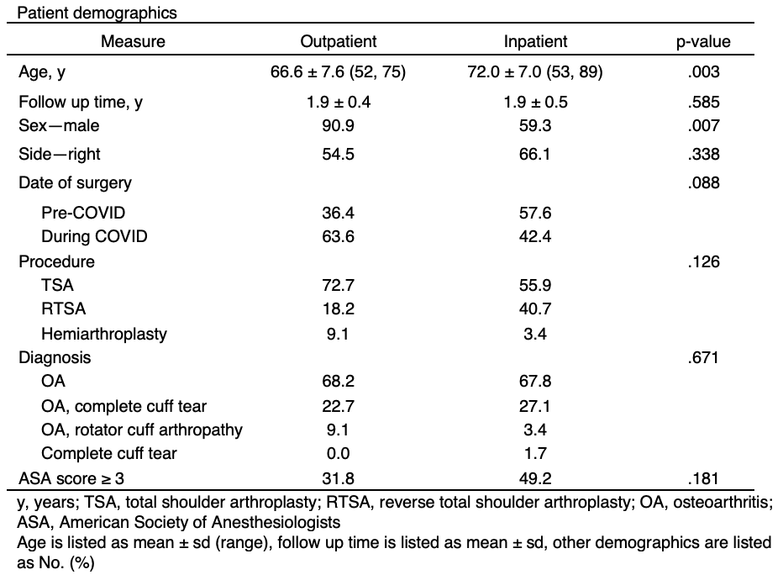
Results: Demographics
Notes:
Pre-COVID: June 2019 – Feb 2020
COVID: March 2020 – Dec 2020

Slide 10
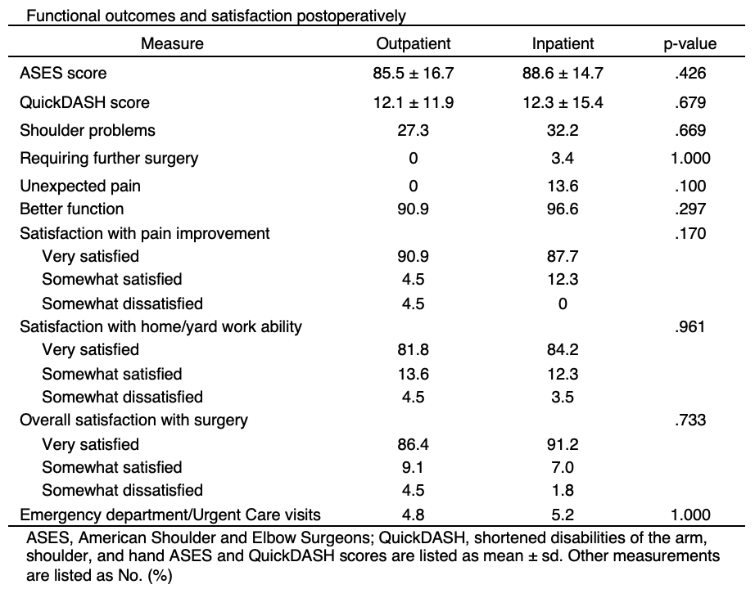
Results: Functional Outcomes and Satisfaction Postoperatively

Slide 11
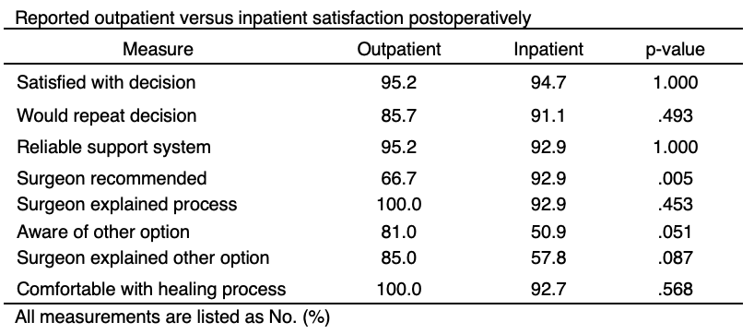
Results: Outpatient Versus Inpatient Satisfaction Postoperatively
Notes:
Point out no difference in reliable support system

Slide 12
Results: Reason for Decision
Outpatient
Better home environment (6 of 17)
Didn’t like hospitals (3 of 17)
COVID-19 restrictions (3 of 17)
Inpatient
No choice/surgeon recommended (26 of 52)
Desired inpatient care (16 of 52)
No reliable support system (6 of 52)

Slide 13
Conclusion
No difference in satisfaction for outpatient and inpatient SA
Patients tend to prefer outpatient surgery
Creating a postop plan for patients without a reliable support system can potentially increase the number of outpatient candidates

Slide 14
References
Leroux TS, Basques BA, Frank RM, et al. Outpatient total shoulder arthroplasty: a population-based study comparing adverse event and readmission rates to inpatient total shoulder arthroplasty. J Shoulder Elbow Surg. 2016 Nov;25(11):1780-1786.
Bean BA, Connor PM, Schiffern SC, Hamid N. Outpatient Shoulder Arthroplasty at an Ambulatory Surgery Center Using a Multimodal Pain Management Approach. J Am Acad Orthop Surg Glob Res Rev. 2018 Oct 23;2(10):e064.
Kramer JD, Chan PH, Prentice HA, Hatch J, Dillon MT, Navarro RA. Same-day discharge is not inferior to longer length of in-hospital stay for 90-day readmissions following shoulder arthroplasty. J Shoulder Elbow Surg. 2020 May;29(5):898-905.
Basques BA, Erickson BJ, Leroux T, et al. Comparative outcomes of outpatient and inpatient total shoulder arthroplasty: an analysis of the Medicare dataset. Bone Joint J. 2017 Jul;99-B(7):934-938.
Calkins TE, Mosher ZA, Throckmorton TW, Brolin TJ. Safety and Cost Effectiveness of Outpatient Total Shoulder Arthroplasty: A Systematic Review. J Am Acad Orthop Surg. 2022 Jan 15;30(2):e233-e241.
Seetharam A, Ghosh P, Prado R, Badman BL. Trends in outpatient shoulder arthroplasty during the COVID-19 (coronavirus disease 2019) era: increased proportion of outpatient cases with decrease in 90-day readmissions. J Shoulder Elbow Surg. 2022 Jul;31(7):1409-1415.
Ilfeld BM, Wright TW, Enneking FK, et al. Total shoulder arthroplasty as an outpatient procedure using ambulatory perineural local anesthetic infusion: a pilot feasibility study. Anesth Analg. 2005 Nov;101(5):1319-1322.
Gallay SH, Lobo JJ, Baker J, Smith K, Patel K. Development of a regional model of care for ambulatory total shoulder arthroplasty: a pilot study. Clin Orthop Relat Res. 2008 Mar;466(3):563-72.
Leroux TS, Zuke WA, Saltzman BM, et al. Safety and patient satisfaction of outpatient shoulder arthroplasty. JSES Open Access. 2018 Feb 15;2(1):13-17.
Puzzitiello RN, Nwachukwu BU, Agarwalla A, et al. Patient Satisfaction After Total Shoulder Arthroplasty. Orthopedics. 2020 Nov 1;43(6):e492-e497.
Vajapey SP, Contreras ES, Neviaser AS, Bishop JY, Cvetanovich GL. Outpatient Total Shoulder Arthroplasty: A Systematic Review Evaluating Outcomes and Cost-Effectiveness. JBJS Rev. 2021 May 6;9(5).
Biron DR, Sinha I, Kleiner JE, et al. A Novel Machine Learning Model Developed to Assist in Patient Selection for Outpatient Total Shoulder Arthroplasty. J Am Acad Orthop Surg. 2020 Jul 1;28(13):e580-e585.

Slide 15
Questions?

