Slide 1
The Use of Preoperative CRP and ESR as Predictive Markers of Prosthetic Joint Infection in Primary Total Hip and Knee Arthroplasty Blake Campbell, OMS-II¹; Noah Embry, MS3³; Josiah Snowden, MS3³; Russell Wagner, MD²
Texas College of Osteopathic Medicine¹,JPS Health Orthopaedic Surgery², Burnett School of Medicine at TCU³

Slide 2
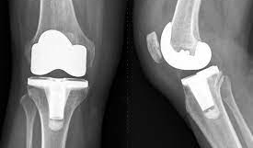
Background
Total hip (THA) and total knee (TKA) arthroplasty are two of the most performed orthopedic surgeries each year in the United States.
Currently, more than 400,000 THA and more than 700,000 TKA are performed each year with recent projections to increase to an estimated 635,000 THAs and 1,260,000 TKAs by year 2030.

Slide 3
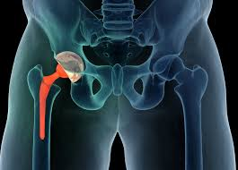
Background
Prosthetic joint infection (PJI) remains one of the most common serious complications among all patients undergoing total joint arthroplasty (TJA).
There has been a significant amount of literature on the use of c-reactive protein (CRP) and erythrocyte sedimentation rate (ESR) in the field of TJA, specifically for the diagnosis of PJI.
However, there is much less data focused on the use of preoperative CRP and ESR in the setting of primary TJA.

Slide 4
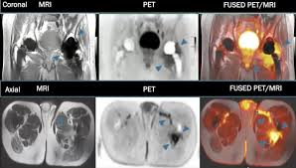
Purpose
The purpose of this study was to further investigate any correlation that exists between preoperative CRP/ESR and PJI in primary TJA.

Slide 5
Methods
All patients of one of two surgeons who underwent primary THA or TKA between 2016 and 2020 at the same institution were identified and studied via a retrospective chart review.
Retrospective review of 806 patients at a single institution who underwent THA (n=291) and TKA (n=515). Patient demographics, medical co-morbidities, and occurrence of PJI or revision for any other cause were extracted

Slide 6
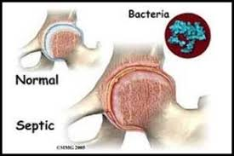
Methods
Positive CRP was set at >0.3 mg/dL and ESR as >30 mm/hr.
PJI was defined as any patient with positive culture after primary TKA/THA or those that underwent revision with diagnosis of PJI.

Slide 7
Results Table
In our current study, which is the second-largest cohort to date that looks at preoperative inflammatory markers before primary TJA, we found no statistically significant correlation between pre-operative CRP or ESR and PJI.
We did find that a higher proportion of patients with PJI had elevated preoperative CRP (70.6%) vs those with normal CRP (29.4%).
Distribution of Both a Positive C-Reactive Protein and Positive Erythrocyte Sedimentation Rate, by Infection
 | Periprosthetic Joint Infection | No Mention of Periprosthetic Joint Infection | P-Value
Positive ESR and Postive CRP | 5 (0.6%) | 105 (13.0%) | 0.0557
ESR or CRP are Negative | 12 | 684
Odds of having a Periprosthetic Joint Infection is 2.71 times Higher in Patients with both a Positive ESR or CRP when compared to patients who are negative for either (95% CI: 0.937, 7.860)

Slide 8
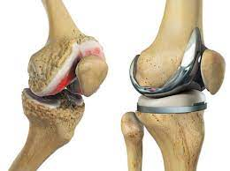
Results
- Of the 806 primary THA and TKA performed, 17 resulted in PJI (2.1%). Overall, 49.9% of patients had no elevation in CRP (<0.3) and 50.1% of patients had elevated CRP (>0.3). 82.8% of patients had no elevation in ESR (30 or less) and 17.3% of patients had elevated ESR (>30). 53.7% of patients had elevation of either CRP or ESR, 46.3% of patients had both normal CRP and ESR, and 13.7% of patients had elevation of both CRP and ESR.
Special note:
Among patients with an elevated CRP/ESR, a potential identifying risk factor (increased BMI, positive urinalysis, current smoking status, diabetes, rheumatoid arthritis, HIV, renal, liver, CHF, or coagulopathy) was identified 95.6% of the time and in 94.0% of cases at least one of the risk factors was potentially modifiable (increased BMI, positive urinalysis, current smoking status).
Obesity (BMI >30) was associated with 4.2 times higher odds of having elevated preoperative CRP (P-value <0.0001)

Slide 9
Discussion
This study is unable to validate the use of preoperative CRP/ESR as a predictive measure of future risk of PJI in primary total joint arthroplasty.
While the majority of PJI cases occurred in patients with positive preoperative CRP values (70.6%), it did not reach statistical significance.
Moreover, in the cohort that was free from PJI, there was an even distribution of positive and negative CRP values pre-operatively.
In our analysis of the patients that did have elevated pre-operative inflammatory markers, a large proportion (>90%) had modifiable risk factors that could potentially cause the elevation in CRP/ESR.
Future studies with larger numbers may be used to further strengthen this conclusion

Slide 10
Discussion
However, this study does provide quantitative insight into the prevalence of elevated preoperative inflammatory markers in all patients prior to TJA with a considerable proportion of patients having modifiable risk factors.
Since there is such a large proportion of patients with elevated inflammatory markers that do not go on to develop PJI, we do not recommend cancellation of TJA unless there is an obvious identified modifiable risk factor that puts them at increased risk of PJI.

Slide 11
Acknowledgements
Special thanks to:

Slide 12
Questions?

Slide 13
References
Projected Volume of Primary Total Joint Arthroplasty in the U.S., 2014 to 2030
T Pfitzner 1 DK, C Perka, G Matziolis. C-reactive protein. An independent risk factor for the development of infection after primary arthroplasty. Orthopade. 2008;11(37):1116-1120
Buchheit J, Uhring J, Sergent P, Puyraveau M, Leroy J, Garbuio P. Can preoperative CRP levels predict infections of bipolar hemiarthroplasty performed for femoral neck fracture? A retrospective, multicenter study. European Journal of Orthopaedic Surgery & Traumatology. 2015;25(1):117-12
Image references in order as they are seen
1. https://www.google.com/imgres?imgurl=https%3A%2F%2Fcached.imagescaler.hbpl.co.uk%2Fresize%2FscaleWidth%2F952%2Fcached.offlinehbpl.hbpl.co.uk%2Fnews%2FPGH%2FiStock_12017545_
2. https://www.google.com/imgres?imgurl=https%3A%2F%2Fphoenixspineandjoint.com%2Fwp-content%2Fuploads%2F2019%2F08%2Fshutterstock_
3. https://www.google.com/imgres?imgurl=https%3A%2F%2Fwww.auntminnie.com%2Fuser%2Fimages%2Fcontent_images%2Fpho_redir%2F2021_12_07_00_25_6904_2021_12_07_C-11_infection.jpg&imgrefurl=https%3A%2F%2Fwww.auntminnie.com%2Findex.aspx%3Fsec%3Dlog%26itemID%3D134472&tbnid=jaQab6_j9P_N1M&vet=12ahUKEwi0g4ODjIz7AhX
4. https://www.google.com/imgres?imgurl=https%3A%2F%2Fthenurseszone.com%2Fwp-content%2Fuploads%2F2015%2F08%2FProsthetic-joint-infections-PJI-2.jpg&imgrefurl=https%3A%2F%2Fthenurseszone.com%2Fprosthetic-joint-infections-pji%2F&tbnid=rhBatSkR8iMulM&vet=12ahU
5. https://www.google.com/imgres?imgurl=https%3A%2F%2Fembed.widencdn.net%2Fimg%2Fveritas%2Fkdf2zvlwge%2F1200x675px%2Fknee-replacement.png&imgrefurl=https%3A%2F%2Fwww.arthritis-health.com%2Fsurgery%2Fknee-surgery%2Fwhen-consider-knee-replacement-surgery&tbnid=3XYBaKfNpG3evM&vet=12ahUKEwiYt9GPjoz7AhX0nWoFHf9ZAGQQMygVegUIARDiAQ..i&docid=

